Slide 1
Deep Learning
« The man when the computer dreams »

Slide 2
Introduction
Google research blog
Publication of June 17th, 2015
Going deeper into neural networks

Slide 3
Plan
Some definitions
Actual use
Artistic part

Slide 4
Définition 1/2
Machine Learning :
Take a lot of Data
Take Big algorithm
Group twice
Two parts :
Teach Parts (show the way to the algorithm)
Automated Parts
A special way to solve problem without understanding them

Slide 5
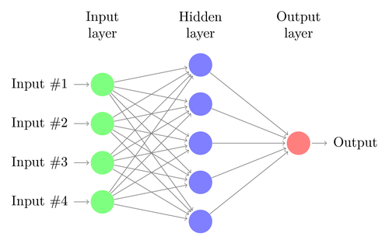
Definition 2/2
Deep Learning
A class of Machine Learning (Supervised algorithm)
Supervised = system will learn to classify
Composed of neural network
1 = good result
0 = bad result
]0;1[ = not enough precise
Example of neural network

Slide 6
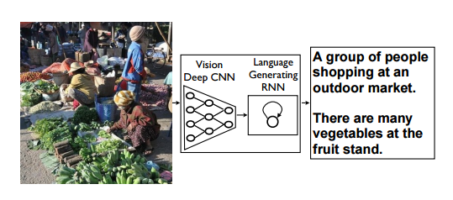
Actual Use 1/3
With deep learning you can :
Discribe picture
Classify people
… etc

Slide 7
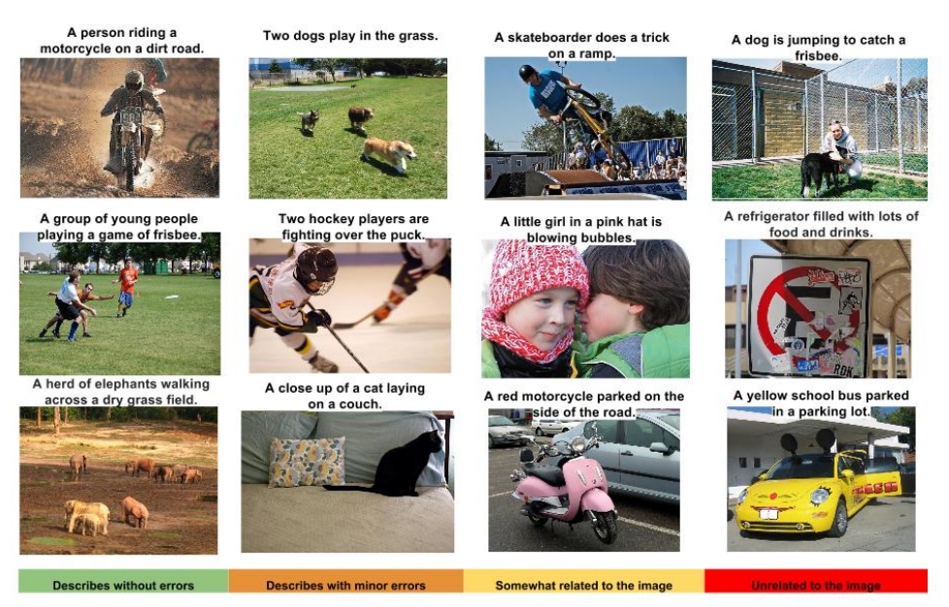
Actual Use 2/3

Slide 8
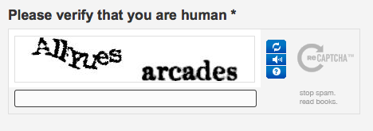
Actual Use 3/3
Captcha
Teached Part
Automated Part

Slide 9
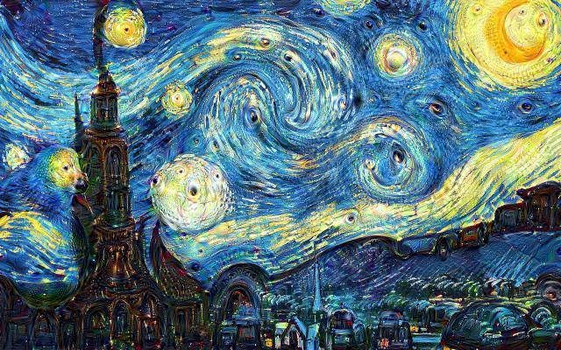
Artistic Part 1/2
Starry Night,
Vincent Van Gogh

Slide 10
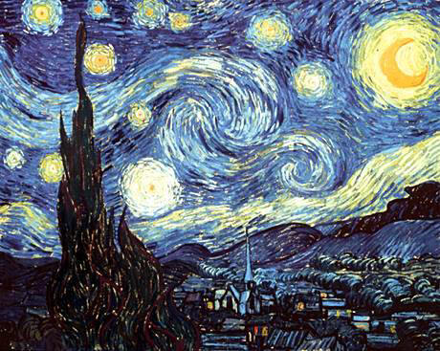
Artistic Part 2/2
A large Database of Images
A sorting algorithm
+

Slide 11
Conclusion
Artificial Intelligence = danger for humanity ?

Slide 12
Sources/Bibliography
http://googleresearch.blogspot.fr/2015/06/inceptionism-going-deeper-into-neural.html
http://www.texample.net/tikz/examples/neural-network/
http://thecreatorsproject.vice.com/blog/what-do-computers-dream-of-when-they-look-at-art
http://arxiv.org/pdf/1411.4555v1.pdf

Slide 13
Questions ?

Slide 14
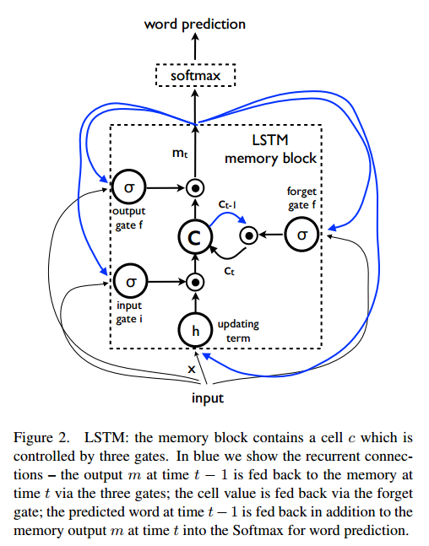
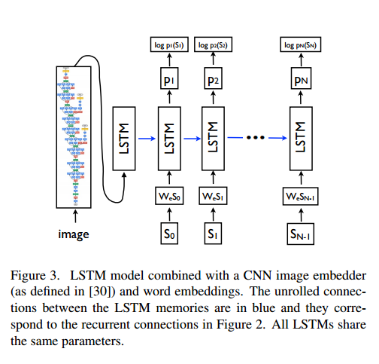
To go further
Long short Term Memory

Slide 15
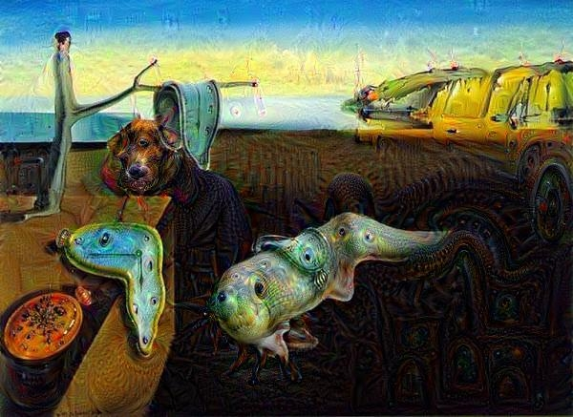
Few more pictures
The Persistence of Memory, Salvador Dalivia

Slide 16
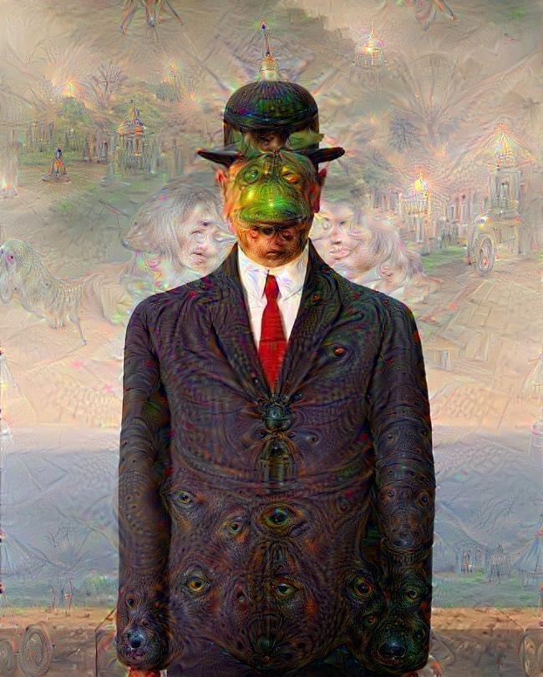
Few more pictures
The Son of Man, René Magritte

Slide 17
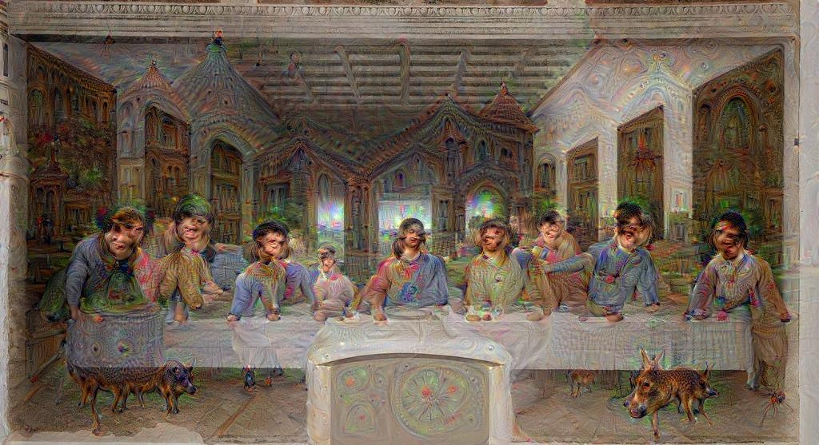
Few more pictures
The Last Supper, Leonardo DaVinci

Slide 18
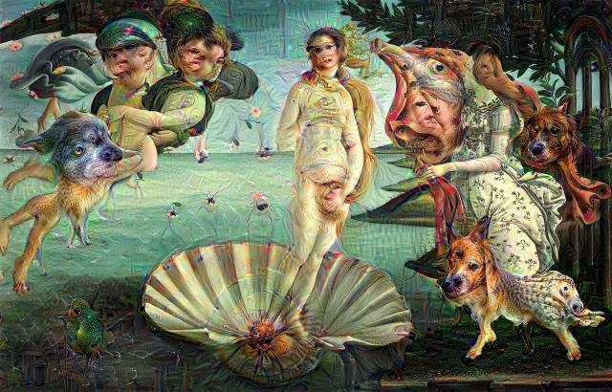
Few more pictures
The Birth of Venus, Sandro Botticelli

Slide 19
Find more
https://www.deepdreamit.com

